Slide 1
Synaptic Plasticity

Slide 2
Learning Objectives
Differentiate types of learning
Describe cellular mechanisms of habituation and sensitization
Describe how changes at synapses may underlie memory consolidation and forgetting.
Compare and contrast LTP and LTD

Slide 3
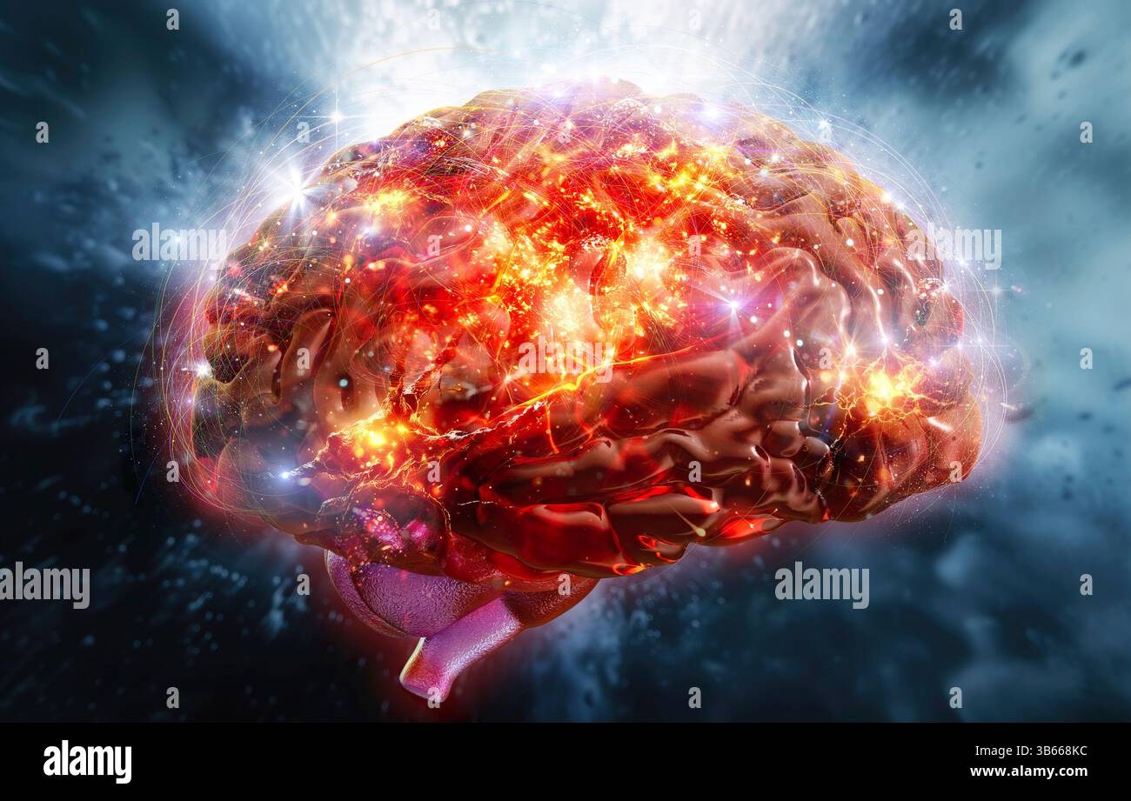
Synaptic Plasticity
Experience (or activity) dependent modifications of synaptic transmission.
Some changes are short-term (several minutes or less), while others are long-term (≥30min)

Slide 4
Short-term Forms of Synaptic Plasticity

Slide 5
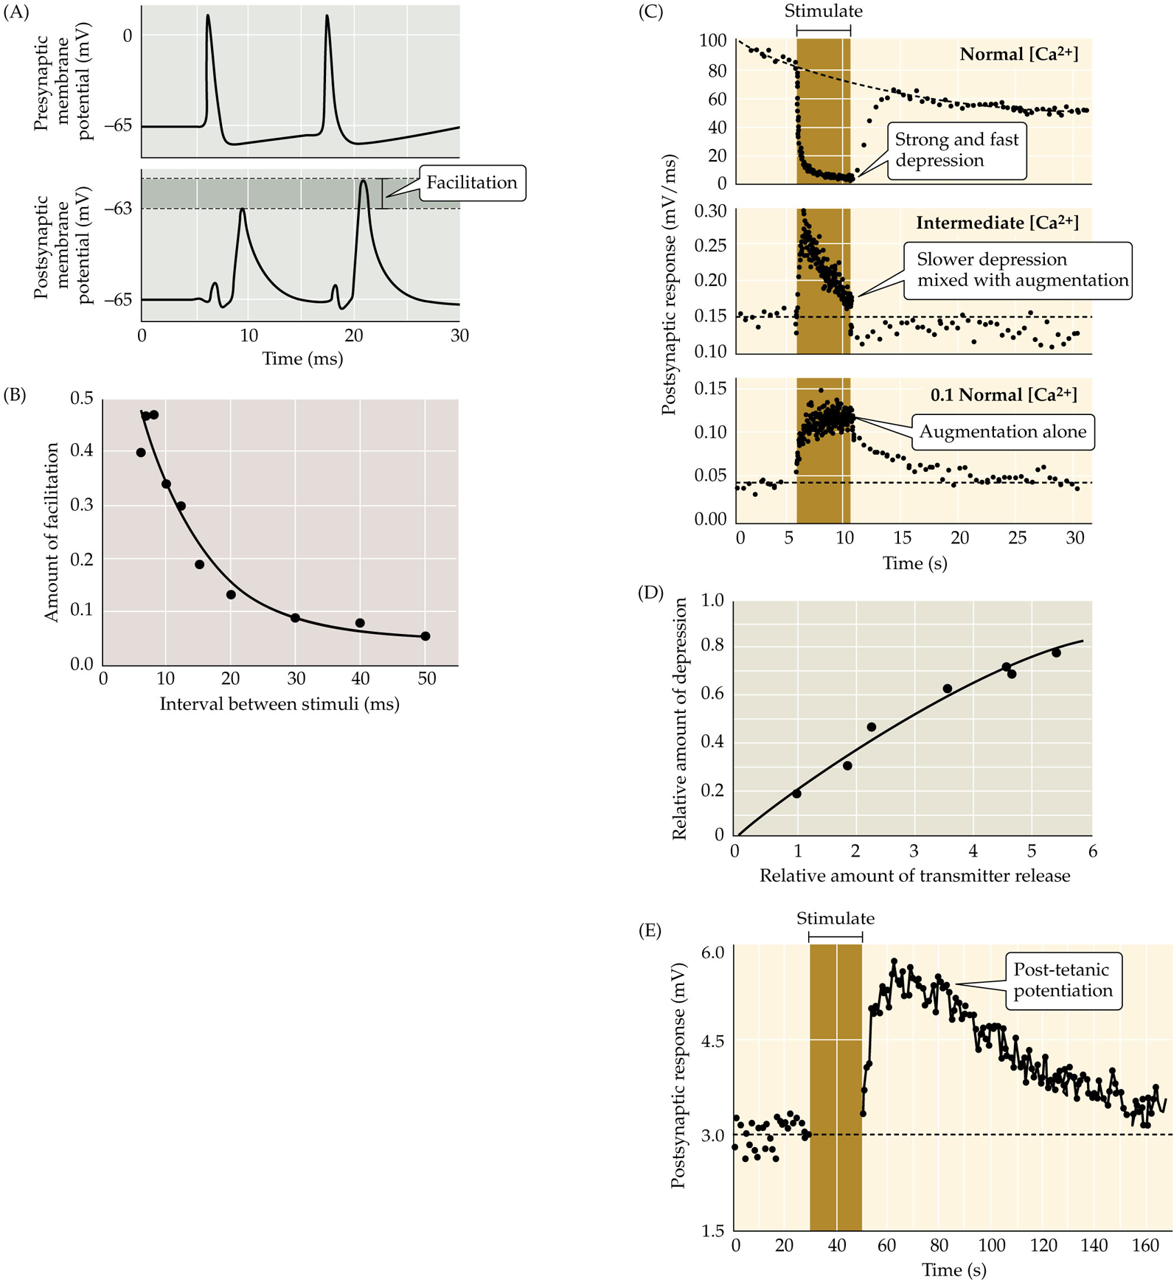
Synaptic Facilitation
a rapid increase in synaptic strength that occurs when two or more action potentials arrive at the presynaptic terminal within a few milliseconds of each other
Facilitation decays over tens of milliseconds
May occur due to prolonged elevation of presynaptic calcium.

Slide 6
Synaptic Depression
A short-term decrease in synaptic strength associated with NT depletion.
Dependent on the amount of NT released
May be due to progressive depletion of vesicles available for release

Slide 7
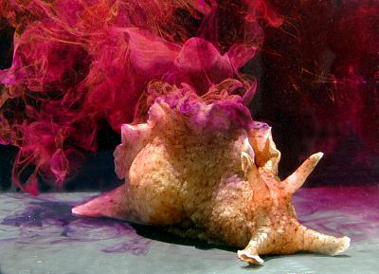
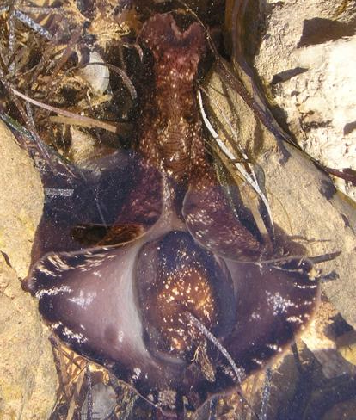
Studying Short and Long-term Forms of Synaptic Plasticity Using Aplysia Californica

Slide 8


Slide 9
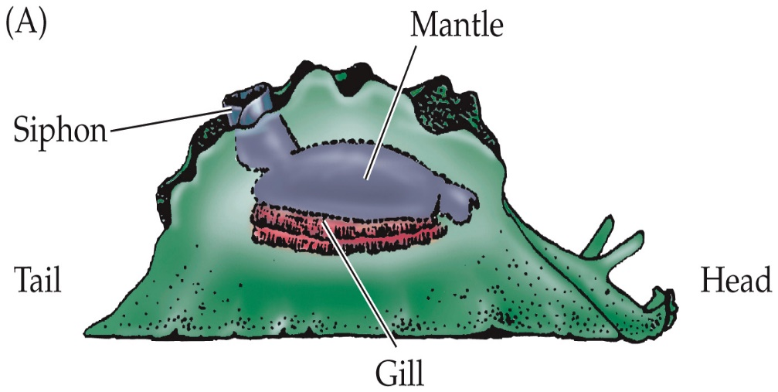
Types of Learning Demonstrated by Aplysia
Habituation
Reduced behavioral responsiveness to the repeated occurrence of a sensory stimulus. Repeated weak siphon stimulation = weaker gill response
Sensitization
A process that allows an animal to generalize an aversive response to a variety of other, non-noxious stimuli. Tail shock + siphon touch = stronger gill response

Slide 10
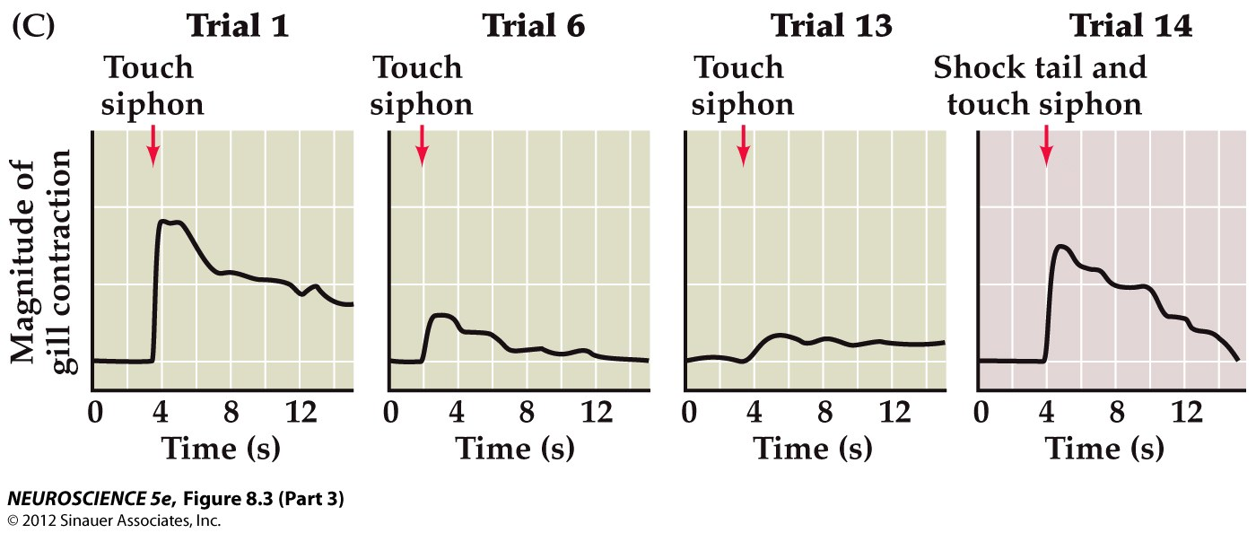
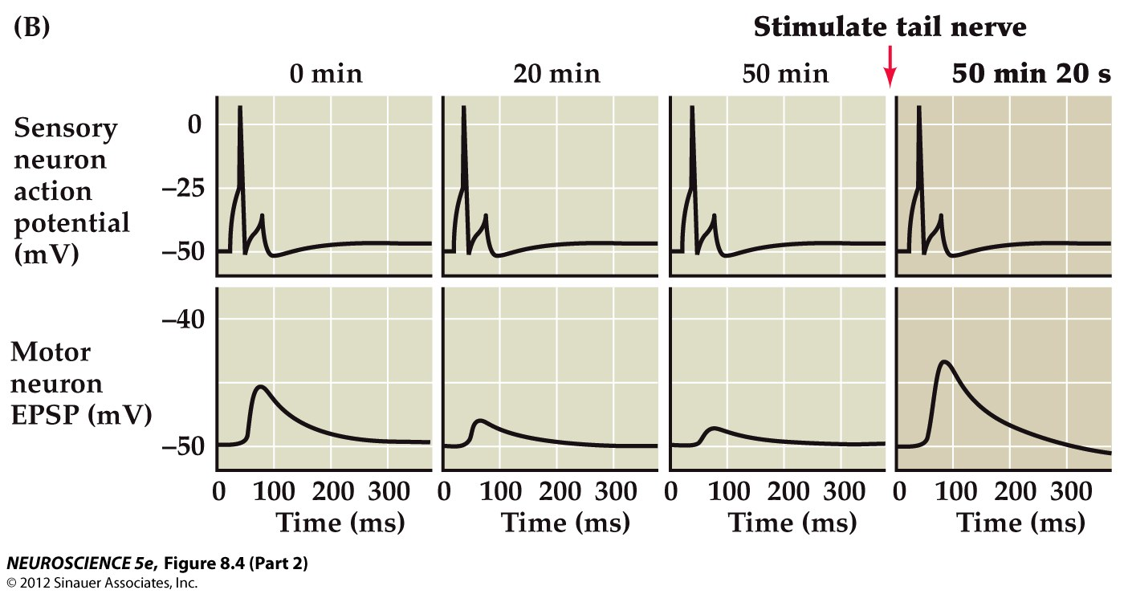
Repeated tactile stimulation of the siphon causes habituation of gill withdrawal reflex

Slide 11
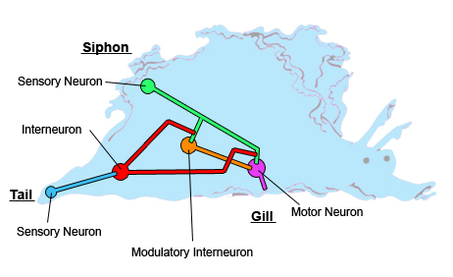
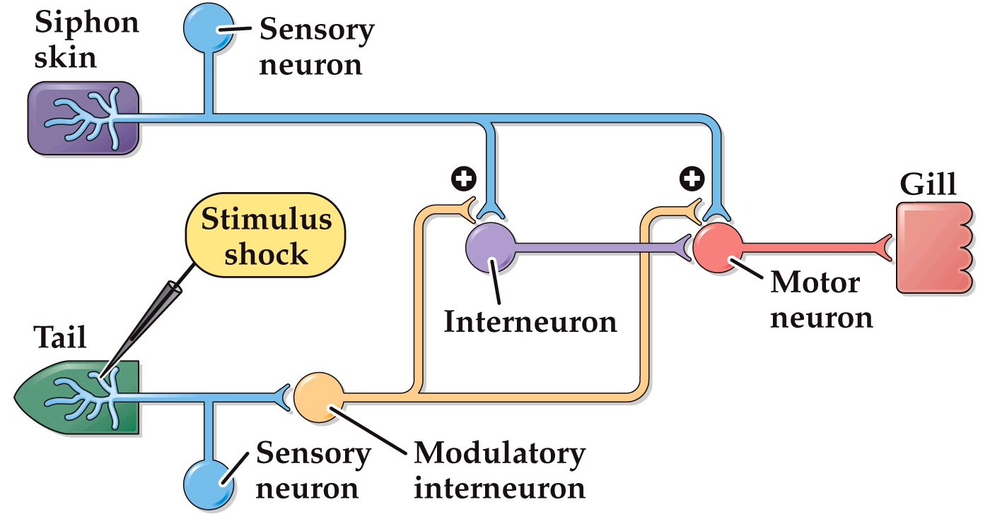
The synaptic mechanism of habituation of Aplysia gill withdrawal reflex
Repeated stimulation of the siphon
Habituation (behavior)
Short-term Synaptic depression (cellular)

Slide 12
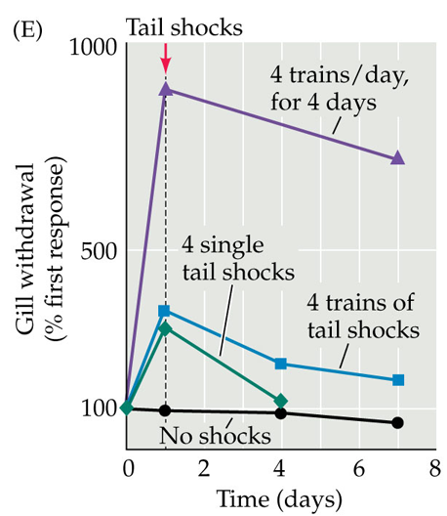
Noxious stimulation of the tail causes sensitization of the gill withdrawal reflex

Slide 13
Synaptic mechanisms of sensitization

Slide 14
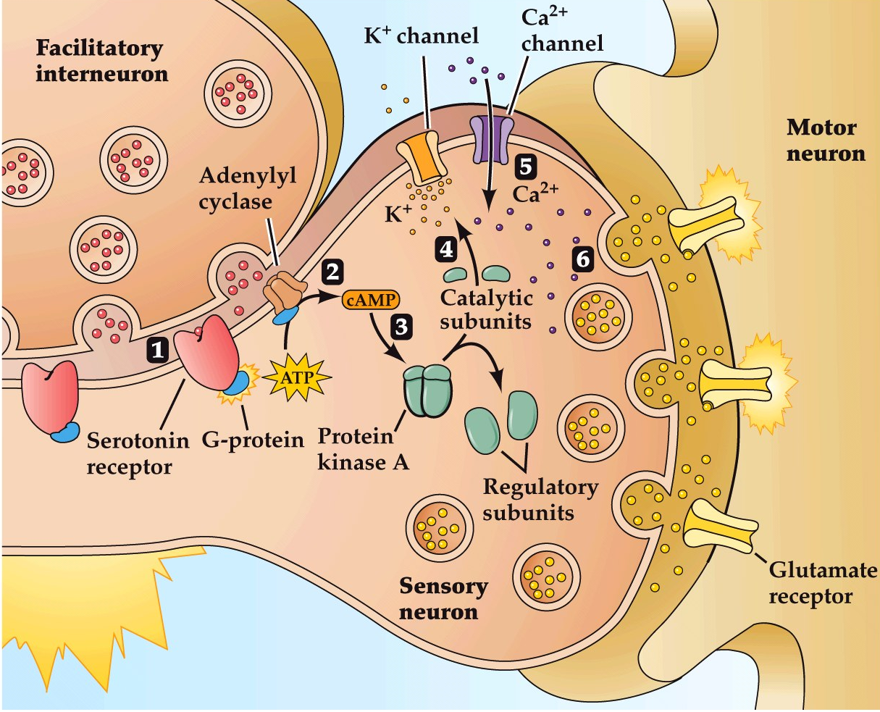
The synaptic mechanisms of short-term sensitization

Slide 15
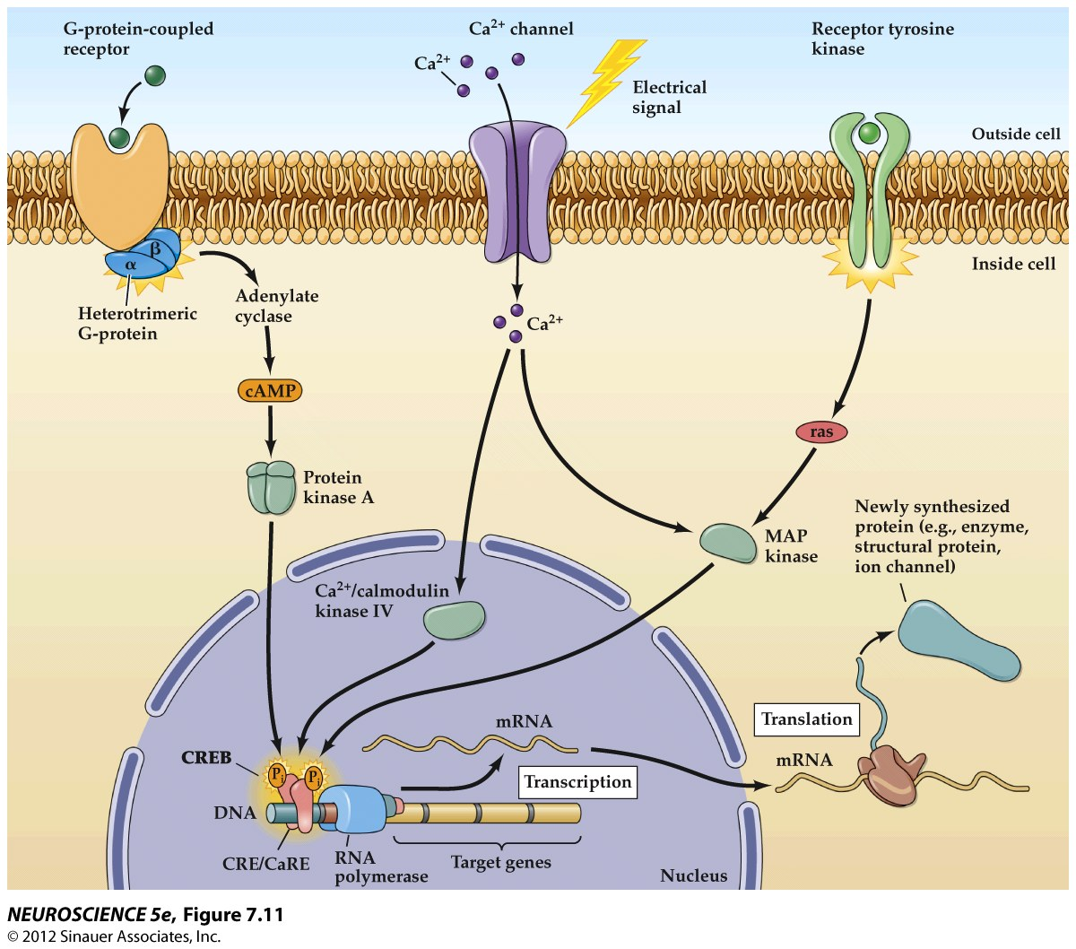
Receptors
G proteins
Effectors
2nd messengers
Late effectors (kinases)
Transcription factors
Protein and/or gene changes

Slide 16
Receptors
G proteins
Effectors
2nd messengers
Late effectors
IN releases 5-HT onto (presynaptic) S, activates 5-HT receptor
5-HT-R is G protein coupled to AC
cAMP levels increase
AC is converts ATP to cAMP
cAMP binds PKA R-subunits, which activate PKA C-subunits
PKA phosphorylates K⁺ & Ca²⁺ channels
RESULT: Transmitter release from sensory neuron is increased, causing greater EPSP in motor neuron
Changes in protein function

Slide 17
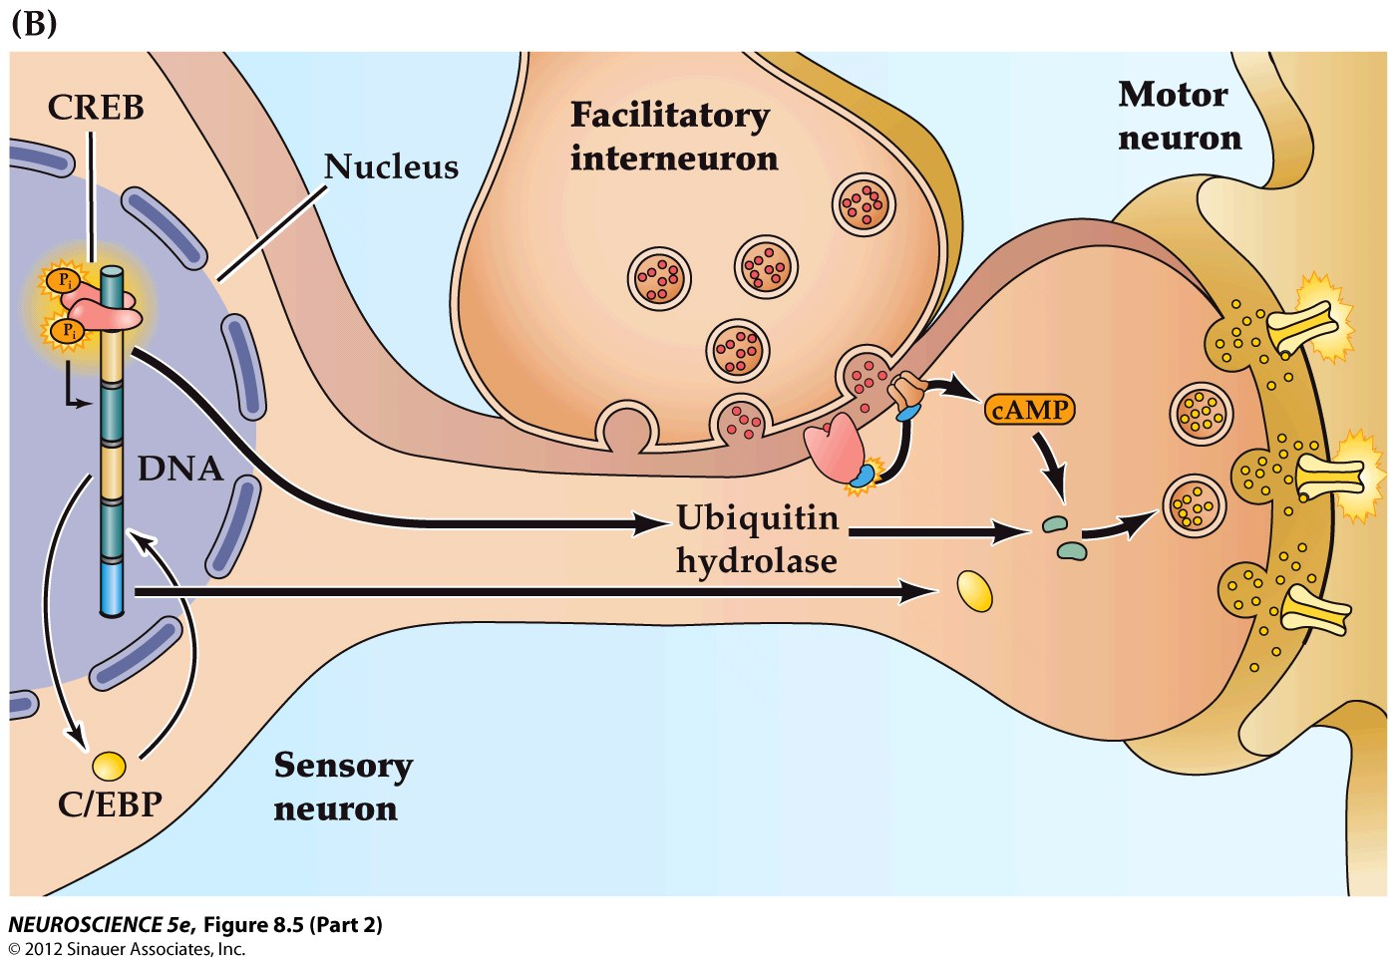
Long-term (weeks-long) sensitization requires changes in gene transcription
1
PKA phosphorylates CREB
2
2
pCREB activates TF’s
1
3
Ubiquitin hydrolase
4
C/EBP
3
4
5
CPEB

